Slide 1
3RD SEMESTER B.TECH COMMUNITY PROJECT REVIEW
Intelligent Ambulance Route Clearer
Literature survey, existing-system analysis, research gaps, and proposed improvements
CMR Institute of Technology, Bengaluru

Slide 2




01 — SYSTEM FRAME
Ambulance navigation is a systems problem
Ambulance Response Time
Urban response time is shaped by congestion, road accessibility, route choice, and intersection delay.
Traffic Congestion
Intersection Delay
Road Accessibility
Route Choice
The project question: how can route optimisation, verified local roads, and clearance coordination work together without claiming control the prototype does not implement?
Intelligent Ambulance Route Clearer
2

Slide 3
02 — LITERATURE FRAME
The literature separates routing from control, then starts recombining them
Review evidence
Key gap
Route optimisation, signal pre-emption, lane reservation, and mixed strategies are distinct research families.
Reviews call for more dynamic traffic data, travel-time uncertainty, advanced algorithms, multi-vehicle safety, and real-world deployment.
Project implication: begin with an implementable route-and-coordination layer; treat signal control as a documented integration boundary.
Intelligent Ambulance Route Clearer
3

Slide 4


03 — DYNAMIC ROUTING
Dynamic routing research moves beyond shortest distance
The route is evaluated as a changing system, not a static line between two points.
Lesson
On-Demand Greenwave
EMVLight
Routing weights need travel time, variance, congestion, and downstream effects, not distance alone.
Combines ETA reliability with elastic signal pre-emption in time-varying networks; reports about 30% response-time reduction in a real-world application.
Extends Dijkstra for real-time route updates while decentralised reinforcement-learning agents coordinate signal phases.
Intelligent Ambulance Route Clearer
4

Slide 5

Recent work connects routing, V2X, and traffic coordination
EVPRT
Jointly considers priority allocation, dynamic routing, and signal pre-emption with V2X communication and MARL/GAT methods.
Multistakeholder EMS
Combines ambulance assignment, hospital choice, lane pre-clearing, and traffic-operator involvement in a mixed-integer model.
V2X Communication
Vehicle-to-everything data exchange
Dynamic Routing
Real-time route adjustments
Algorithm lens
Emergency Traffic Coordination
Orchestrating responses for faster emergency movement
Dijkstra is a dependable baseline; A* can accelerate goal-directed search; ML/RL/V2X add dynamic modelling but require data, infrastructure, validation, and safety controls.
Signal Pre-emption
Priority control of traffic lights
Ambulance Assignment
Dispatch and resource allocation
Boundary
An interface that requests acknowledgement from authorised personnel is not the same as automatic signal pre-emption.
Intelligent Ambulance Route Clearer
5

Slide 6





05 — EXISTING SYSTEMS
Existing systems are strong in different layers
Google Maps
Waze
Mappls
General navigation, traffic and disruption alerts, user contributions, and authority partnerships; emergency-vehicle-specific routing is not publicly documented here.
Community-powered incident reporting, validation, live alerts, and dynamic rerouting.
Indian navigation with live traffic intelligence, junction views, signal timers, door-level navigation, and hyperlocal safety alerts.
HERE
ERSS 112 / 108 context
Enterprise-grade mapping and traffic capabilities are relevant comparators; emergency-specific public details should be stated only when documented.
Emergency intake, location, dispatch, GIS, and live vehicle tracking address response coordination rather than a public shortcut-verification network.
Intelligent Ambulance Route Clearer
6

Slide 7
06 — COMPARISON MATRIX
Capability is not the same as integration
Use “Not publicly documented” where public evidence does not establish absence. The proposed column describes intended capabilities, not completed implementation.
Criteria | Google Maps | Waze | Mappls | HERE | ERSS 112 | Proposed project
General navigation | Yes | Yes | Yes | Yes | Partial | Partial
Live traffic information | Yes | Yes | Yes | Yes | Partial | Planned
Alternative route selection | Yes | Yes | Yes | Yes | Not publicly documented | Planned
Dynamic rerouting | Yes | Yes | Yes | Yes | Not publicly documented | Planned
Community road reports | Yes | Yes | Partial | Not publicly documented | No | Planned
Ambulance-specific routing | Not publicly documented | Not publicly documented | Not publicly documented | Not publicly documented | Partial | Planned
Verified local shortcut network | Not publicly documented | Not publicly documented | Not publicly documented | Not publicly documented | Not publicly documented | Planned
Traffic personnel coordination | Not publicly documented | Not publicly documented | Not publicly documented | Specialised integration only | Partial | Planned acknowledgement workflow
Intelligent Ambulance Route Clearer
7

Slide 8
07 — DEFENSIBLE GAP
The defensible gap is an integrated, ambulance-focused workflow
Integrate emergency constraints
Verify local roads
General navigation already provides traffic, incidents, and rerouting; the gap is combining emergency-specific constraints in one workflow.
Local shortcuts should be community-sourced, then verified for ambulance suitability, accessibility, and reliability before entering the graph.
Update route comparison
Coordinate clearance
Reported roadblocks should update route comparison and trigger alternatives, with uncertainty surfaced to the operator.
Traffic coordination can be represented as requests, acknowledgements, and status updates without claiming automatic signal control.
Intelligent Ambulance Route Clearer
8

Slide 9
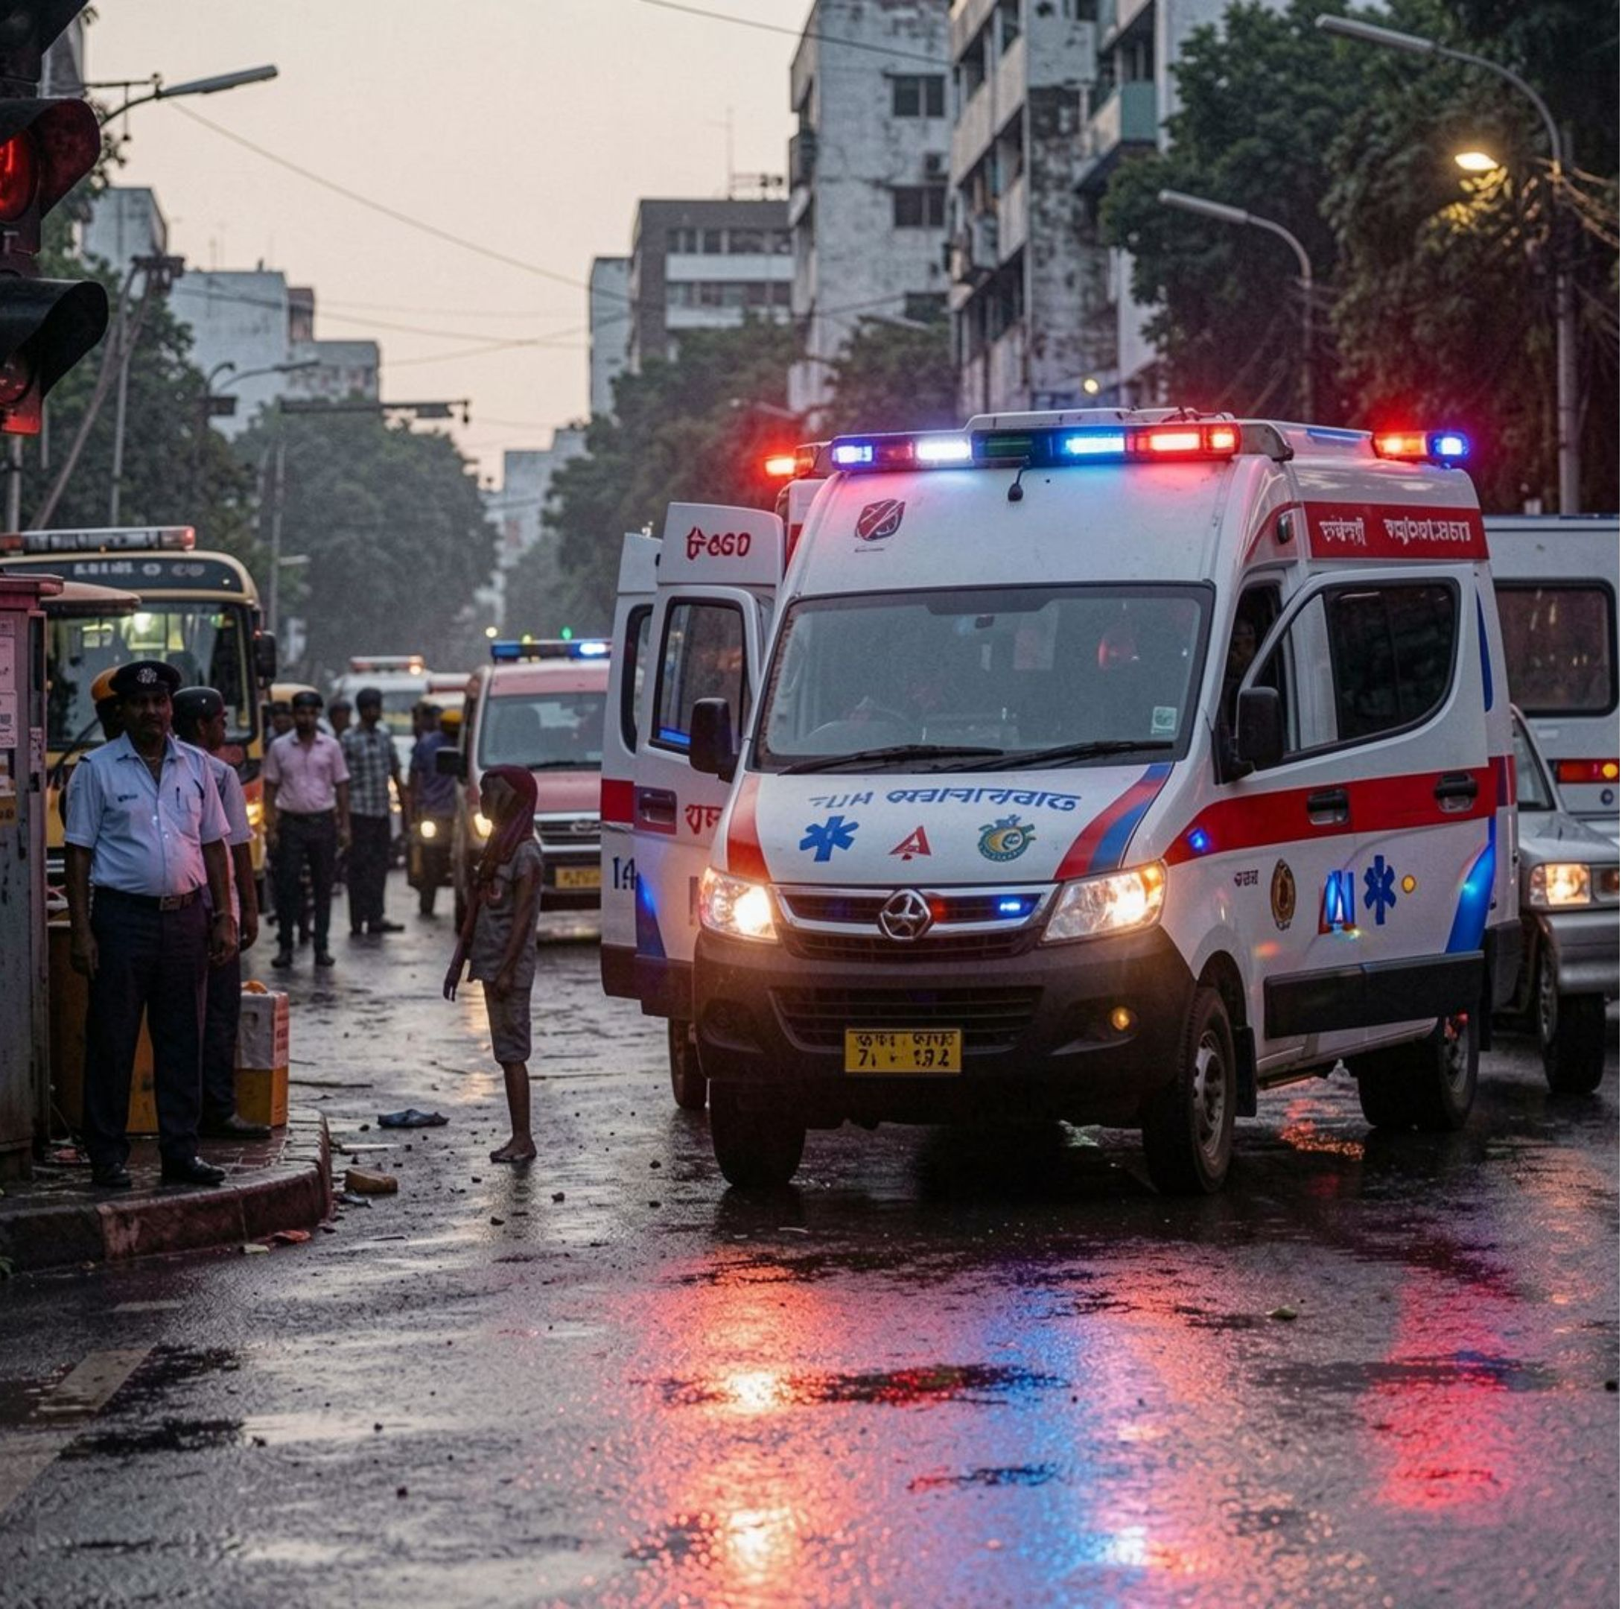
08 — PROPOSED SYSTEM
Route intelligence plus human coordination
Route optimisation: Compare Dijkstra/A* alternatives using ETA, distance, traffic, road accessibility, and roadblock status.
Community-verified roads: Collect local knowledge, review it, record confidence and constraints, and integrate approved edges into the network.
Clearance workflow: Identify critical intersections, send requests to authorised personnel, capture acknowledgement, and show status to the ambulance operator.
Project boundary: Software interface or simulation for coordination; no claim of hardware control or live government-system connectivity.
9

Slide 10
09 — CONCLUSION / REFERENCES
Conclusion and references
Finding: Dynamic routing and traffic coordination can reduce emergency delay, but many approaches depend on simulation, specialised infrastructure, or unavailable data.
Gap: Existing apps and public systems provide valuable navigation, traffic, reporting, dispatch, GIS, and tracking, but do not publicly document one integrated ambulance-focused workflow with verified local shortcuts and acknowledgement-based clearance.
Contribution: Prototype the three proposed modules, test route quality and coordination latency, and avoid claiming superiority or automatic signal control before experiments.
IEEE REFERENCES
Humagain et al., Transport Reviews, 2020, doi:10.1080/01441647.2019.1649319
Min et al., IEEE TITS, 2019, doi:10.1109/TITS.2019.2923802
Su et al., AAAI, 2022, doi:10.1609/aaai.v36i4.20383
Liu et al., IEEE GLOBECOM, 2023, doi:10.1109/GLOBECOM54140.2023.10436848
Zeng et al., Journal of Transportation Engineering, Part A, 2021, doi:10.1061/JTEPBS.0000577
OFFICIAL DOCUMENTATION
Google Maps India Safety & Disruption Alerts · Waze for Cities Product Waze · Mappls App · Government of India ERSS 112 Features
Intelligent Ambulance Route Clearer
10

